Slide 1
Sonika Rathi
Assistant Professor
BITS Pilani

Slide 2
Agenda
Build Tools – Maven and Gradle
Maven
Gradle

Slide 3
Build Tool - Maven
History
Maven, a Yiddish word meaning accumulator of knowledge
Originally started as an attempt to simplify the build processes in the Jakarta Turbine project
Concept behind building Maven?
There were several projects each with their own Ant build files that were all slightly different and JARs were checked into CVS
Need of a standard way to build the projects, a clear definition of what the project consisted of, an easy way to publish project information and a way to share JARs across several projects
The result is a tool that can now be used for building and managing any Java-based project

Slide 4
Build Tool - Maven
History
With maven, day-to-day work of Java developers get easier and generally it help with the understanding of any Java-based project
Maven addresses two aspects of building software
describes how software is built
describes its dependencies
Maven can also be used to build and manage projects written in C#, Ruby, Scala, and other languages
The Maven project is hosted by the Apache Software Foundation, where it was formerly part of the Jakarta Project
And Initial Release of Maven was : 13 July 2004; 14 years ago

Slide 5
Build Tool - Maven
Software
Maven is a software which collects all your dependency find it from all over internet compile your classes and provide you the final jar/war
JAR: Java Archive Files
WAR: Web Application Resource or Web Application Achieve Files
EAR: Enterprise Archive

Slide 6
Build Tool - Maven
Objective
Making the build process easy
Providing a uniform build system
Providing quality project information
Providing guidelines for best practices development
Allowing transparent migration to new features

Slide 7
Build Tool - Maven
Phases of a standard Maven build
Currently, Maven is likely the most widely used build tool for Java especially in large enterprises
Maven default life cycle comprises a number of predefined and fixed phases
First, the source files are verified, and the build is initialized
Subsequently, the sources and resources are compiled and processed
The same happens with test sources and resources
Afterwards, the result is packaged, and optionally an integration test is run
Finally, the result can be verified, installed, and deployed in an artifact repository
Not all actions are necessarily executed in each phase
In this way Maven offers a skeleton along which your own build logic can be oriented

Slide 8
Build Tool - Maven
Phases of a standard Maven build
Standardized phases, the commands for the compilation and testing of software are the same in each Maven project:
mvn package executes all phases up to packaging and creates a build
mvn test stops at the phase “test.”
validate
compile
test-compile
package
integration test
post-integration test
verify
install
deploy

Slide 9
Build Tool - Maven
Maven POM
Stands for Project Object Model
Describes a project
Name and Version
Artifact Type
Source Code Locations
Dependencies
Plugins
Profiles (Alternate build configurations)
Uses XML by Default

Slide 10
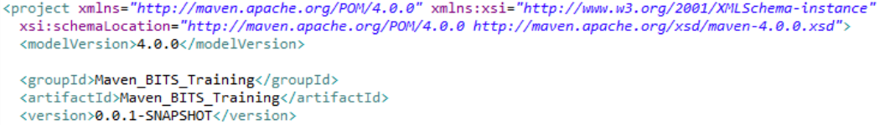
Build Tool - Maven
Project Name (GAV)
Maven uniquely identifies a project using
groupID: Arbitrary project grouping identifier (no spaces or colons)
Usually loosely based on Java package
artfiactId: Arbitrary name of project (no spaces or colons)
version: Version of project
Format {Major}.{Minor}.{Maintenance}
Add ‘-SNAPSHOT ‘ to identify in development
GAV Syntax: groupId:artifactId:version

Slide 11
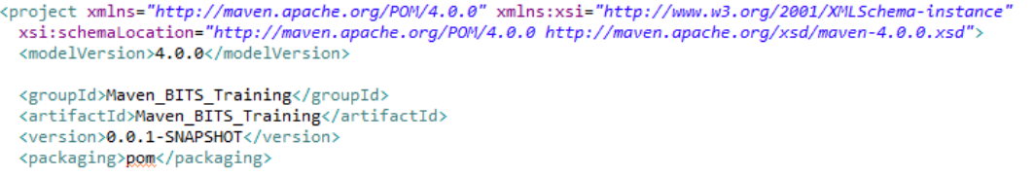
Build Tool - Maven
Packaging
Build type identified using the “packaging” element
Tells Maven how to build the project
Example packaging types: – pom, jar, war, ear, etc.
Default is jar

Slide 12
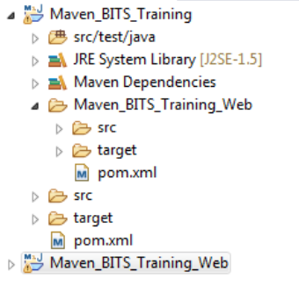
Build Tool - Maven
Multi Module Projects
Maven has 1st class multi-module support
Each maven project creates 1 primary artifact
A parent pom is used to group modules

Slide 13
Build Tool - Maven
Example Maven Goals
mvn install
Invokes generate* and compile, test, package, integration-test, install
mvn clean
Invokes just clean
mvn clean compile
Clean old builds and execute generate*, compile
mvn compile install
invokes generate*, compile, test, integration-test, package, install
mvn test clean
Invokes generate*, compile, test then clean

Slide 14
Build Tool - Gradle
About Gradle
Gradle is an open-source build automation tool focused on flexibility and performance
Gradle build scripts are written in Domain Specific Language [DSL], i.e. Groovy
Groovy resembles Java
Every Java program is also a valid Groovy program, Groovy offers options for writing programs with substantially easier syntax
Why Consider Gradle?
High performance
It is very specific on running only required tasks; which have been changed
Build cache helps to reuse tasks outputs from previous run
It has ability to have shared build cache within different machine
JVM foundation
It has JVM Foundation; where using Java Development Kit is Must
Benefits to use of standard Java API’s in build logic
However it is not limited to Java

Slide 15
Build Tool - Gradle
Gradle concepts
The core concepts of Gradle are tasks and the dependencies between them
Based on these, Gradle calculates a directed, acyclic graph to determine which tasks have to be executed in which order
This is necessary since this graph can change through custom tasks, additional plug-ins, or the modification of existing dependencies

Slide 16
Build Tool - Gradle
Gradle offerings
Gradle also offers the option to extend its functionality by embedding plug-ins
This allows the developer to embed support of other programming languages like Groovy, C++, or Objective-C in Gradle

Slide 17
Build Tool - Gradle
Gradle benefits
Extensibility
You can readily extend Gradle to provide your own task types or even build model
IDE Support
Several major IDEs allow you to import Gradle builds and interact with them
Example: Android Studio, IntelliJ IDEA, Eclipse, and NetBeans
Insight
Build scans provide extensive information about a build run that you can use to identify build issues
They are particularly good at helping you to identify problems with a build’s performance

Slide 18
Build Tool - Gradle
Gradle DAG
Gradle is a general-purpose build tool
Currently it supports Maven- and Ivy-compatible repositories and the filesystem
It supports create and publish custom plugins to encapsulate own conventions and build functionality
The core model is based on tasks
Directed Acyclic Graphs (DAGs) of tasks
Once the task graph has been created
It determines which tasks need to be run in which order and then proceeds to execute them
Example of a Graph
Tasks Consists of:
Action : To perform something
Input : values to action
Output : generated by
Task n
Task 4
Task 5
Task 3
Task 2
Task 1

Slide 19
Build Tool - Gradle
Summary
Gradle has several fixed build phases
It evaluates and executes build scripts in Three Phases
Initialization : Set-up environment & Identify which Projects will be part of it
Configuration: Construct Task graph and then Identify task to be executed in defined order
Execution: Run the task
Gradle is extensible in more ways than one
It allows you to Custom Task Types – Define your own Task Types
Custom Task Actions
Extra Properties on Projects and Tasks
Custom Conventions – User friendly

Slide 20
Build Tool
Gradle vs Maven
Gradle | Maven
Flexibility: Flexibility on Conventions User Friendly & Customized | Flexibility: No flexibility on Conventions It is rigid
Performance: It process only the files has been changed Reusability by working with Build Cache Shipping is faster | Performance: It process the complete build No Build Cache concept Shipping is slow as compared to Gradle
User Experience: IDE Support : Is in evolving Stage CLI : Modern CLI | User Experience: IDE Support : Is mature CLI solution is classic in comparison with Gradle

Slide 21
Thank You!
In our next session:

